Slide 1
ORGANISATION : Tripura Institute of Technology
PROBLEM STATMENT (DB126) : In order to simplify the process of e-tendering and to make the system cost effective and user friendly, the EVC (electronic verification code) system are required to be performed through Aadhaar based OTP, instead of existing Digital Signature Certificate. Design efficient solutions that enable use of Aadhar OTP and DigiLocker for sharing the documents for eTendering.
TEAM NAME : Cookie Army
Team Members :
Fayazuddin Shaik (Team Leader)
Hanifa Shaik
Tulasi Devi Siddani
Ashutosh Mishra
Teja Krishna
Sai Sumanth

Slide 2
Disadvantages of Existing System
Compatibility Issues
Digital Signatures may not run in all the systems that such a variety of users are using. Thus, the system has to be considered before using the Web Portal.
Lack of buy in and resistance-to-change from employees.
This often leads to circumvention of e-Tendering Systems, loss of process control, back door buying, and theft.
Increased Complexity. Often, Digital signatures add complexity, usually because of its way of acquisition and it gets expired and has to get renewed periodically, unlike Aadhar Card.
Narrow Spectrum of Users. Since all the users may not have Digital Signature,unlike Aadhar Card, the existing system does not have a wide spectrum of users.
Cost. Very often, if the above factors are present in a procurement environment, the result will be a staggering loss of money, time and energy.

Slide 3
Description
◆ Registration process is done through Aadhar Based OTP both for the authorized government employee / Nodal Officer and the bidder, as we ask for Aadhar num as the userID.
◆ The confidential data of the users will be uploaded and encrypted with AES Algorithm encryption technique and stored in database.
◆ Employee releases the tenders and then bidding starts for limited time and the bids are listed out in the order of their tender-relevance and one of them is selected by the employee manually, as the best bidder.
◆ The bidder uploads documents using DigiLocker which is encrypted using SHA(Secure Hashing Algorithm), which is embedded in the same portal.
◆ Once the Employee decides the best bidder, he clicks the select button, which generates an Aadhar based OTP that is encoded in UTF-8 format using Text Local API.
◆ If the entered OTP is correct then the tender document will be e-mailed to the bidder.
◆ The contract will be successfully handled to bidder.
Technical Stack
Eclipse ,Java, JavaScript , Jsp , Bootstrap , Jquery , MySql ,Text Local API, Advanced Encryption Algorithm (AES),Encoding (UTF-8),HTML, CSS, SMTP, Secure Hash Algorithms(SHA-256)

Slide 4
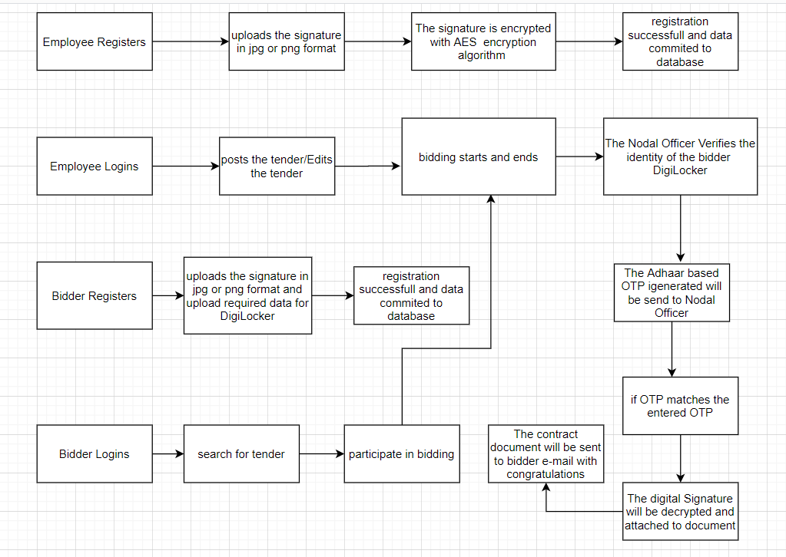
DataFlowDiagram

Slide 5
Advantages
Aadhaar based OTP is way more authentic than EVC(Electronic Verification Code) because OTP instantly changes but not EMC.
AES(Advanced Encryption Standard) Algorithm for Digital Signature Encryption provides better security.
SHA-256(SecureHasingAlgorithm) algorithm helps way more security for password.
DigiLocker helps to validate whether the user and his documents are fake or not.
The presence of an electronic witness to all transactions, the means to communicate quickly and the savings in time and paper are the main factors to persuade clients and their teams to use e-tendering.

Slide 6
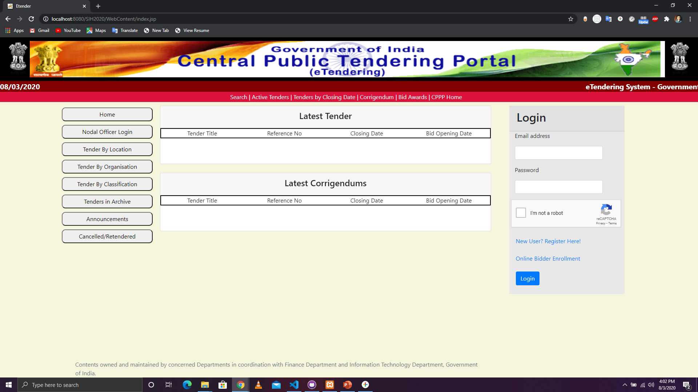
ScreenShots Of The User Interface

Slide 7
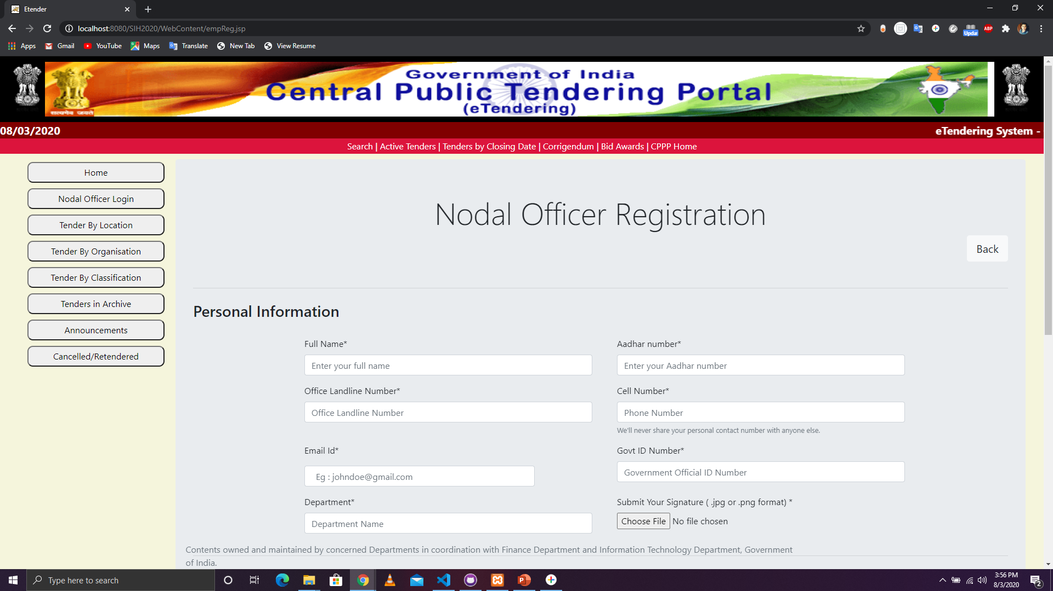

Slide 8
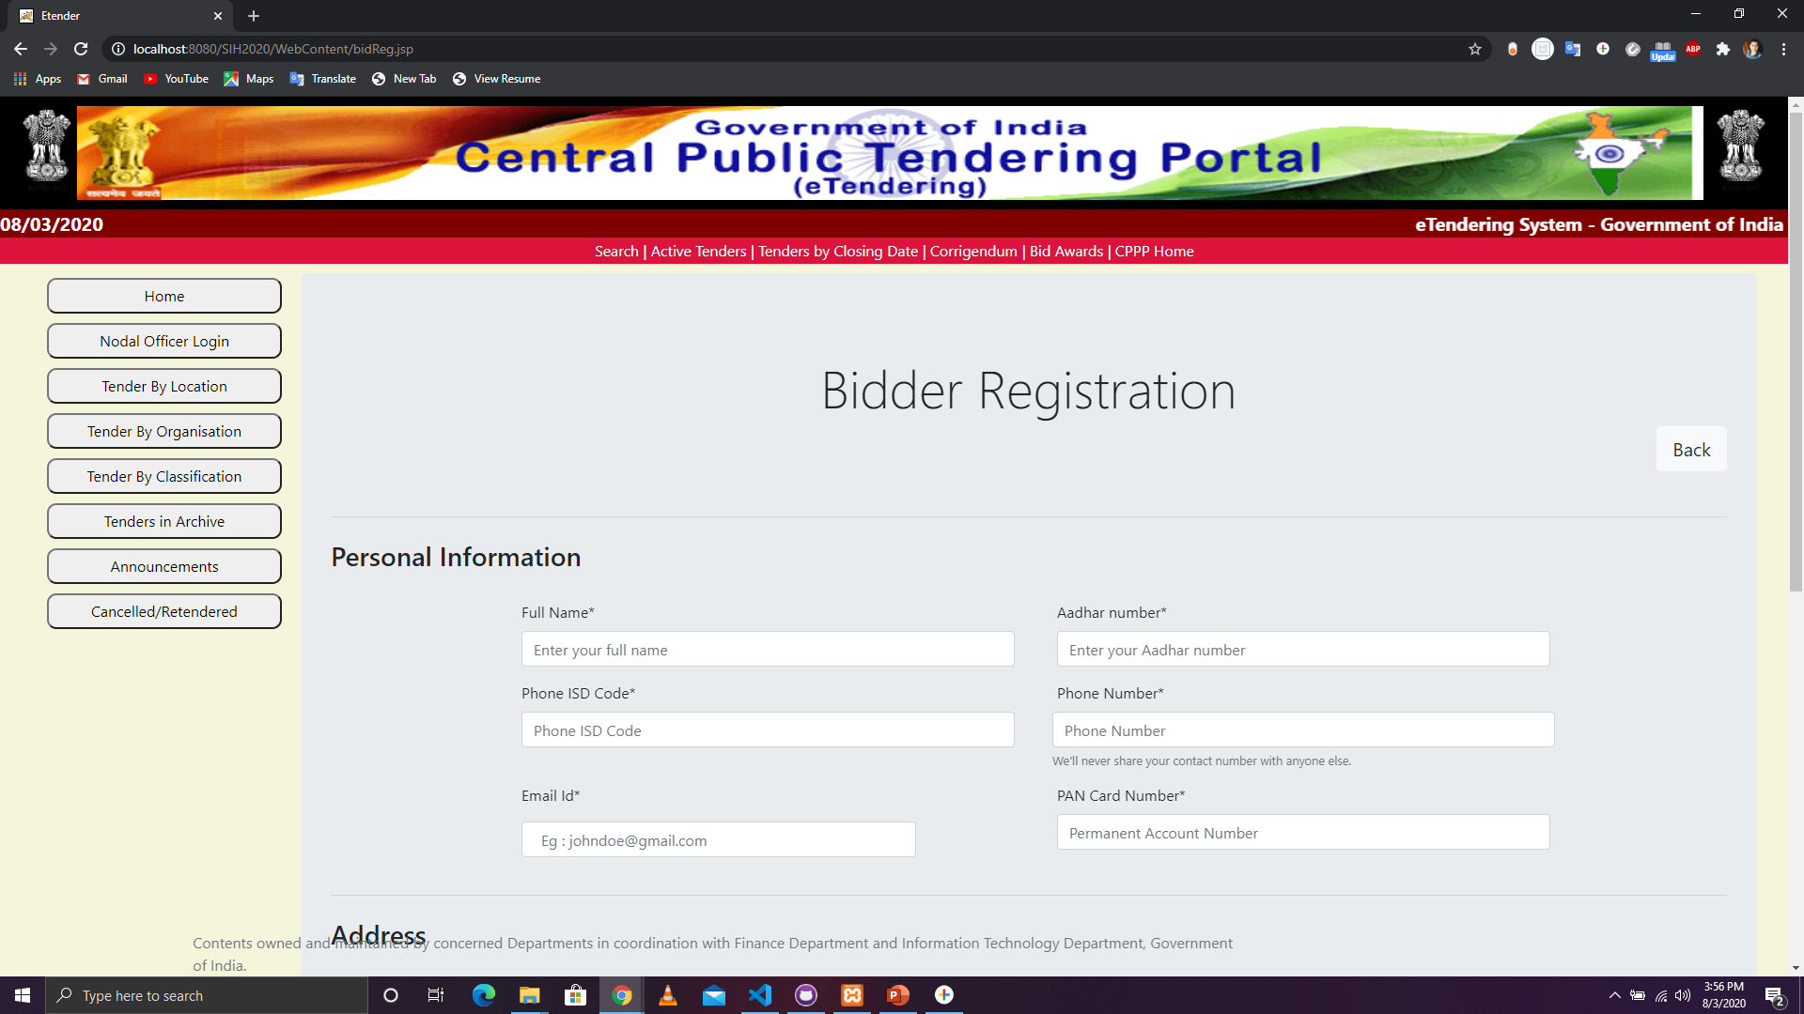

Slide 9
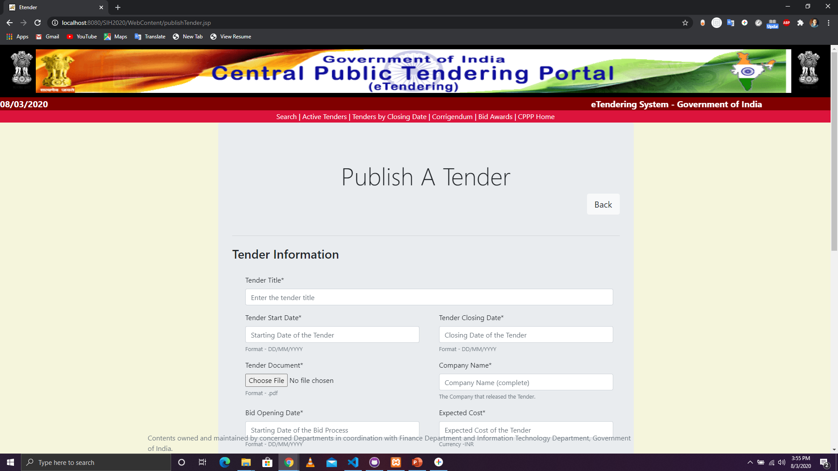

Slide 10
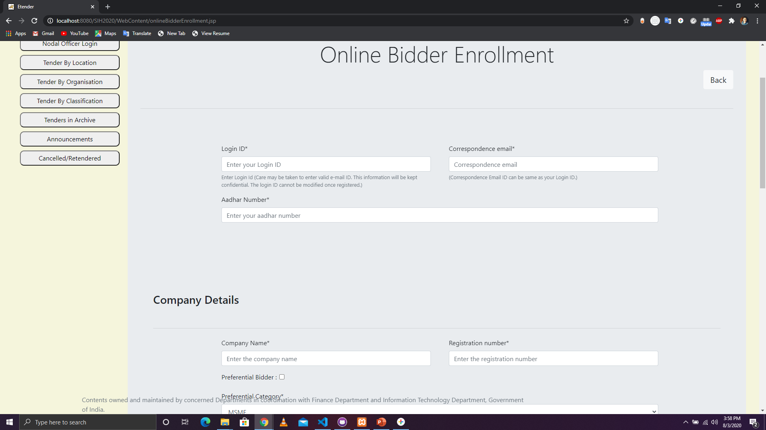

Slide 11
